Slide 1
Performance early preterm (until 28 weeks)
Dataset: all_28

Slide 2
Performance early preterm (until 28 weeks)
Dataset: all_28

Slide 3
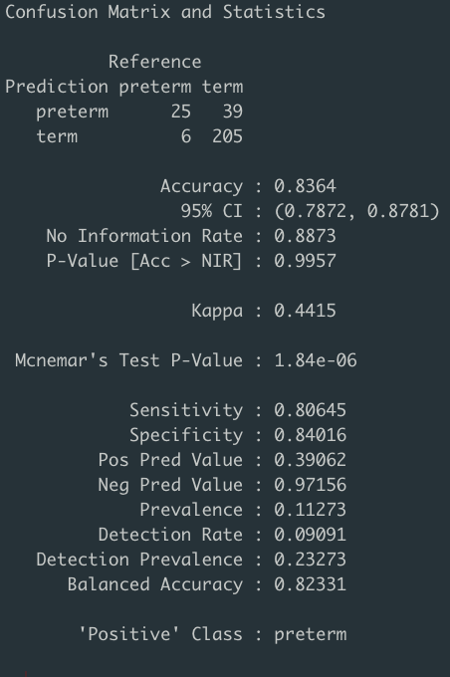
Performance early preterm (until 28 weeks)
Dataset: all_28
Best model: RF from iter 407 with 0.88 thold

Slide 4
Performance early preterm (until 28 weeks)
Dataset: phylotypes_1e0_28

Slide 5
Performance early preterm (until 28 weeks)
Dataset: phylotypes_1e0_28

Slide 6
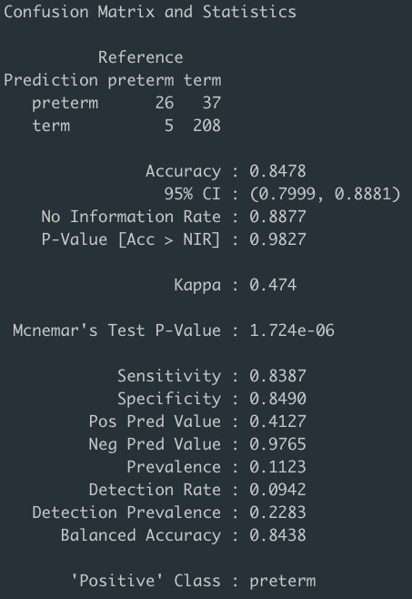
Performance early preterm (until 28 weeks)
Dataset: phylotypes_1e0_28
Best model: RF from iter 443 with 0.81 thold

Slide 7
Performance preterm (until 32 weeks)
Dataset: all_32

Slide 8
Performance preterm (until 32 weeks)
Dataset: all_32

Slide 9
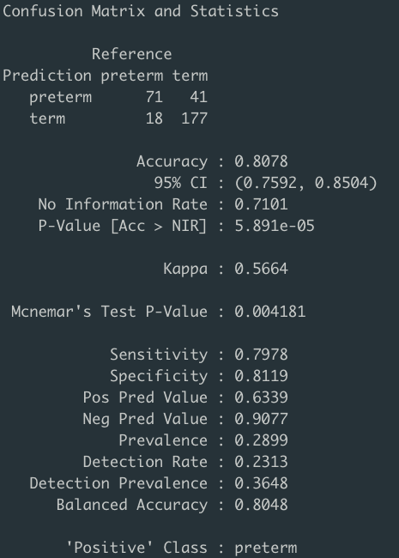
Performance preterm (until 32 weeks)
Dataset: all_32
Best model: RF from iter 357 with 0.68 thold

Slide 10
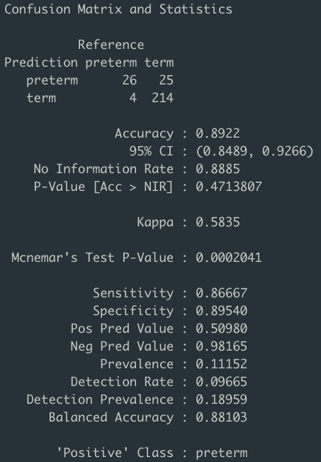
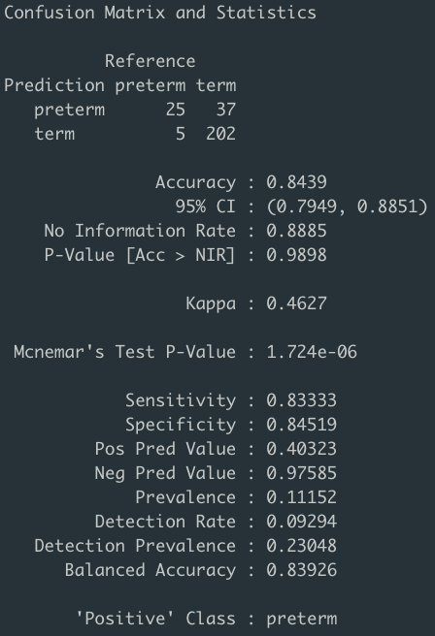
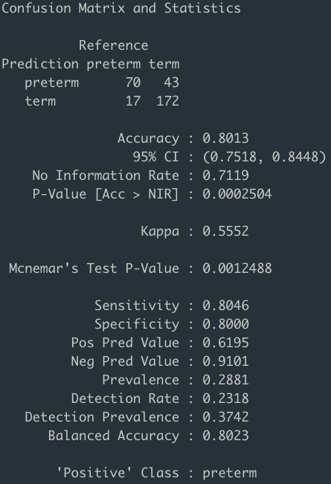
Try Delete collect_week < 10 week in order to reduce noise
all_28 thold 0.84
phylotypes_1e0_28 thold 0.85
all_32 thold 0.7

Slide 11
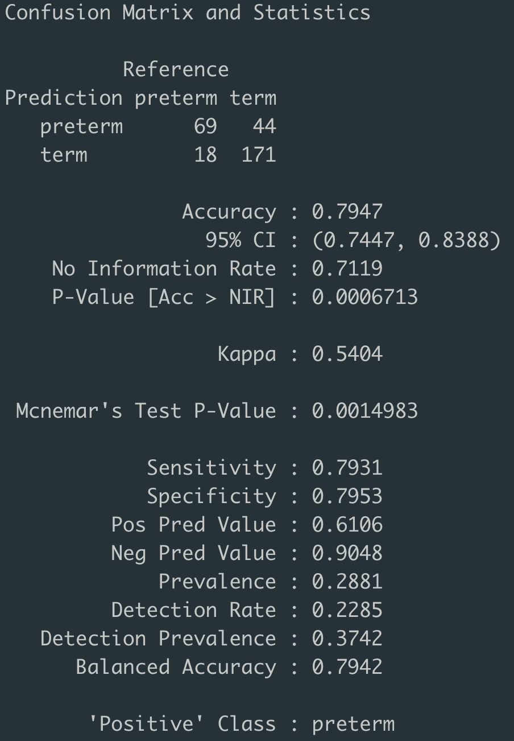
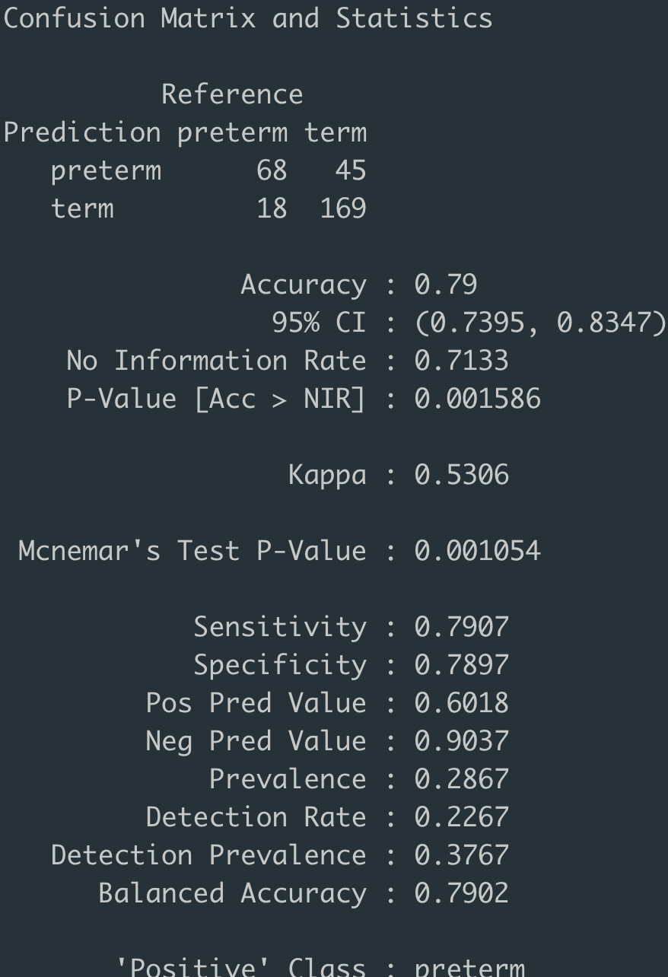
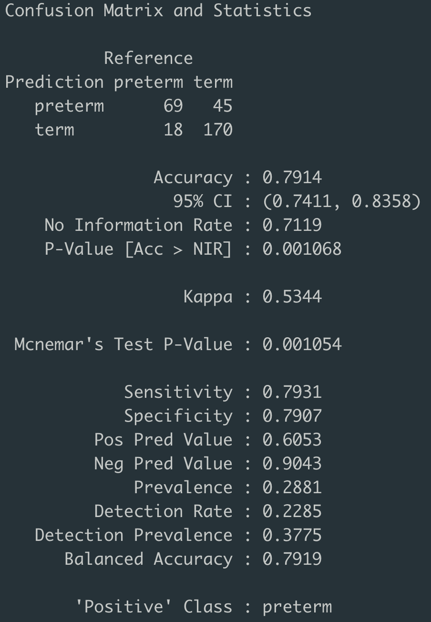
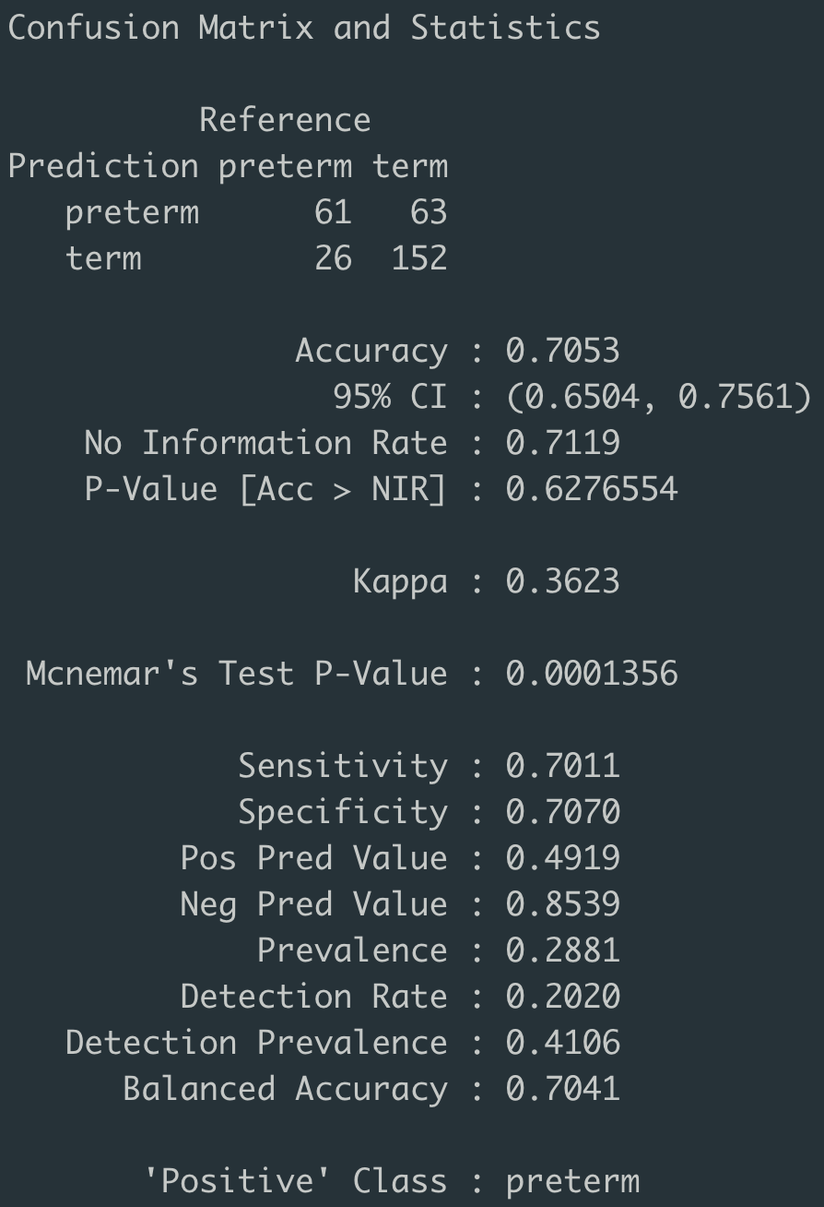
Best selected features models determination
2500_rf: iter 4 thold = 0.70
5000_rf: iter 20 thold = 0.67
5_xgboost: iter 4 thold = 0.71
10_xgboost: iter 114 thold = 0.75

Slide 12
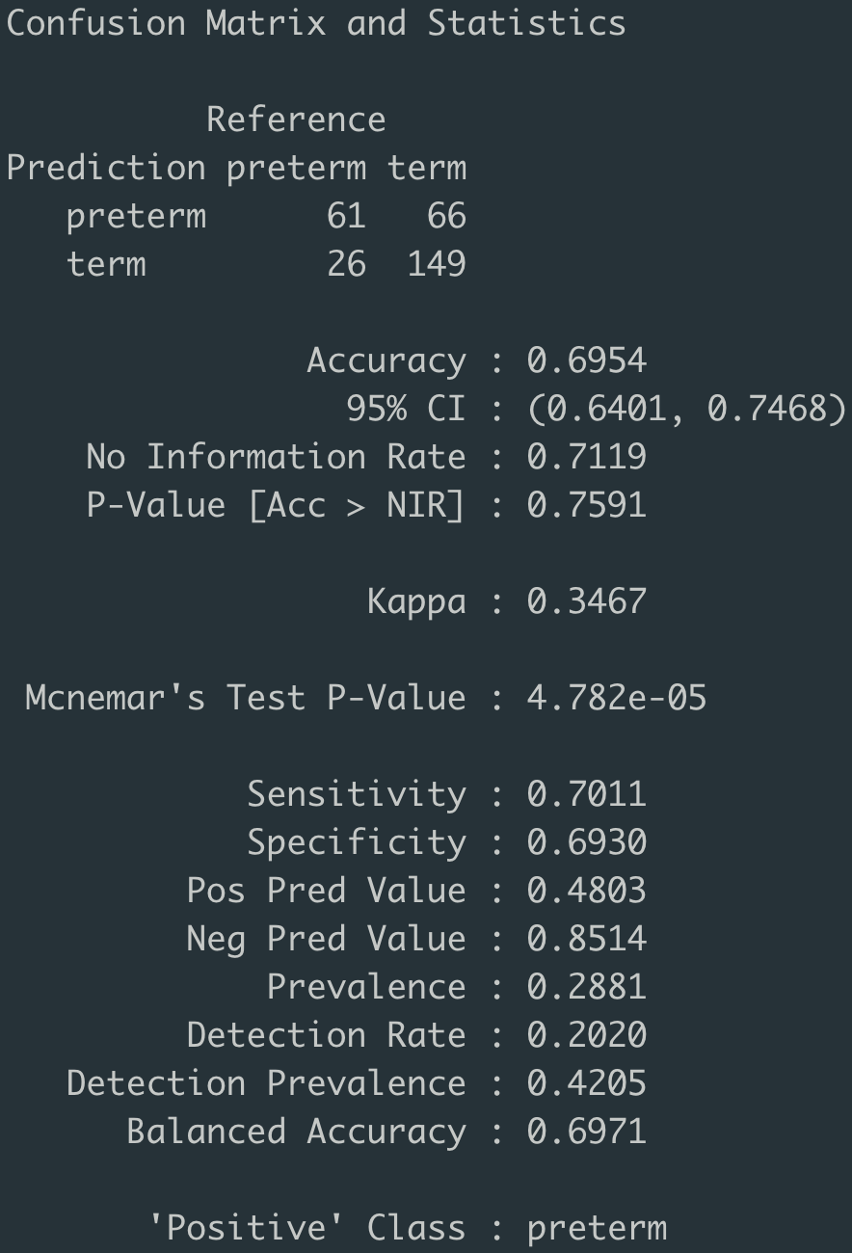
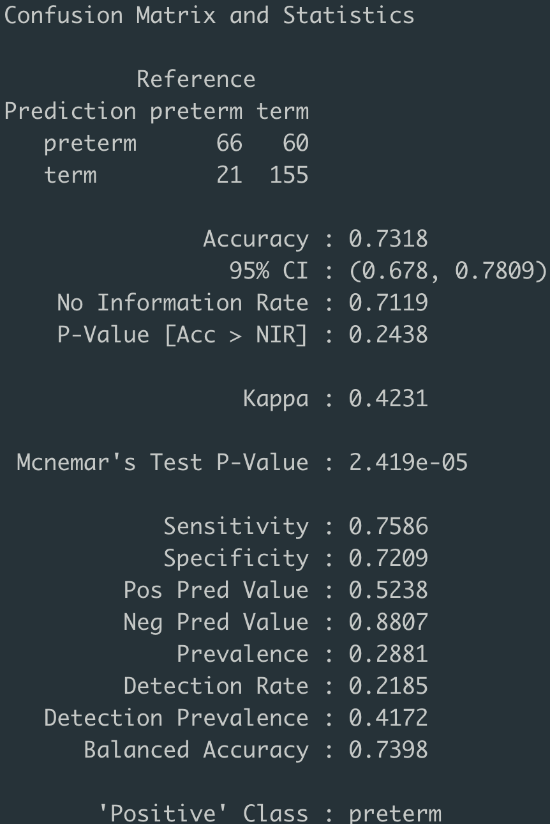
Best selected features models determination
FCBF_rf: iter 332 thold= 0.77
FCBF_xgboost: iter: 168 thold= 0.76

Slide 13
all_32_rf model vs 2500_rf model
Forest plot:

